Slide 1
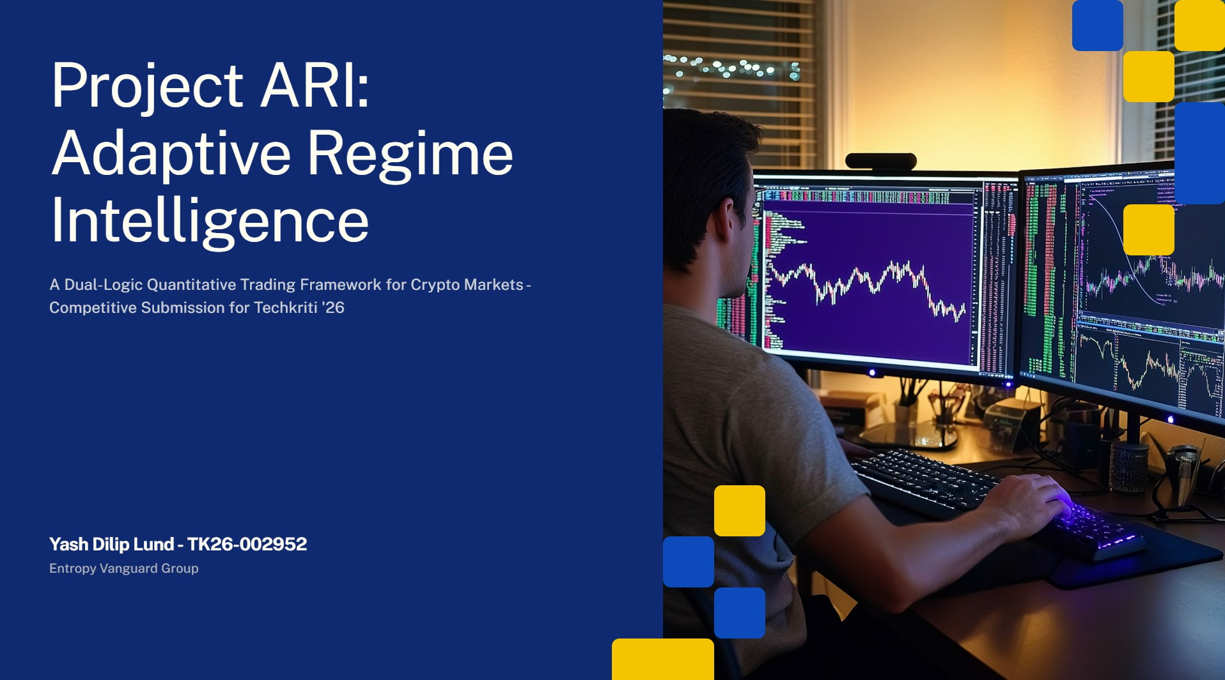

Slide 2
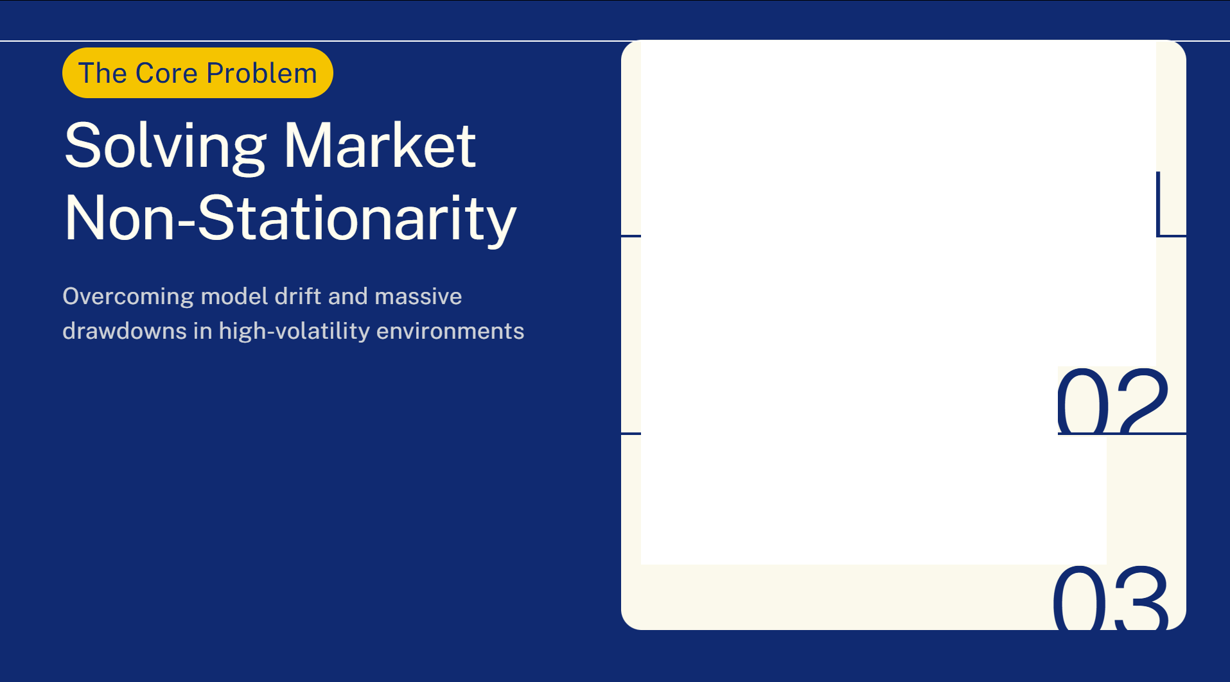

Non-Stationary Dynamics: Standard ML models often fail when market regimes shift abruptly from trending to sideways.
Data Noise: High volatility and outliers, with Volume Z-scores reaching up to 5.0, lead to significant model drift.
Drawdown Penalty: Traditional bots frequently exceed the -30% drawdown limit during severe crypto winters.

Slide 3
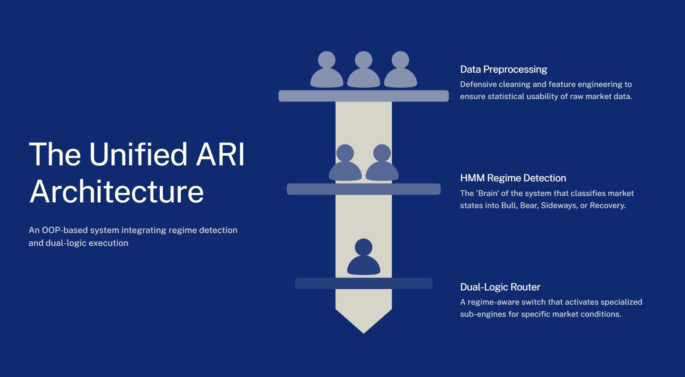

Slide 4
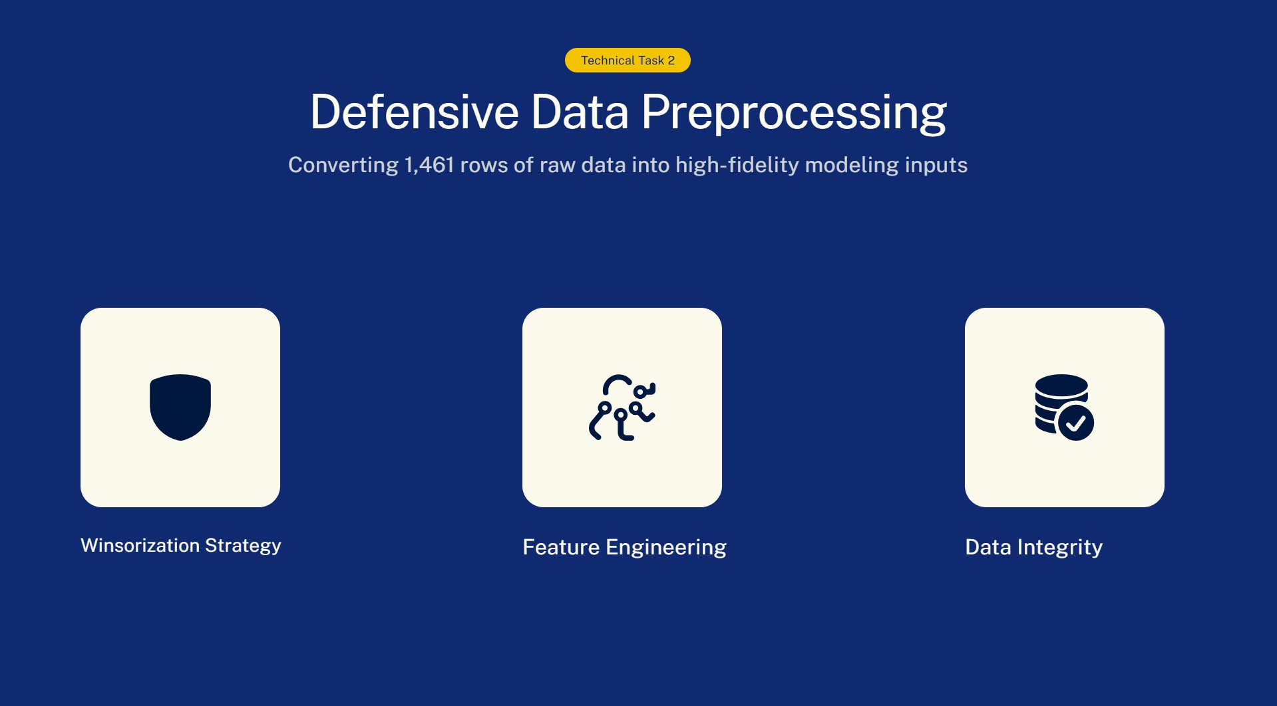

Slide 5
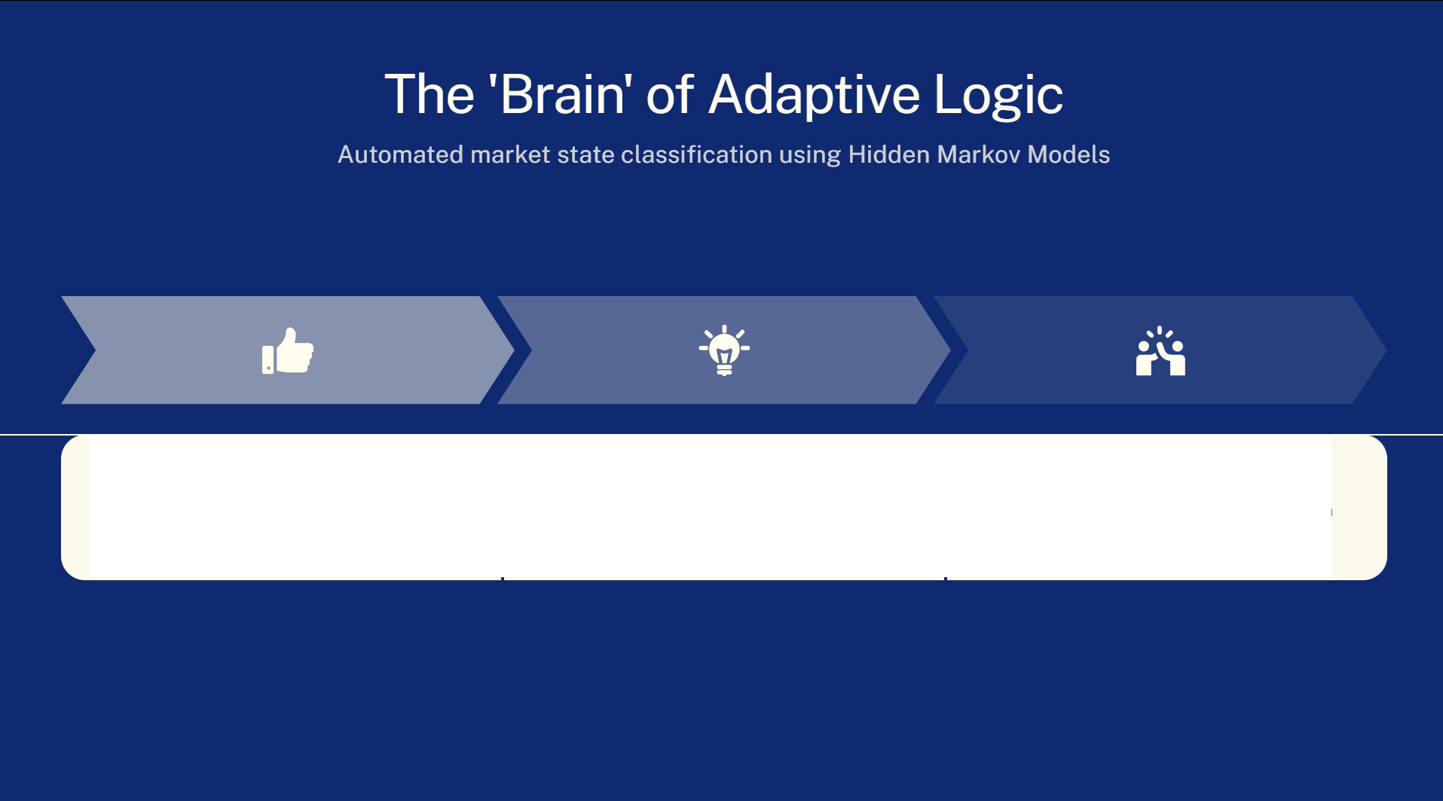
Gaussian HMM
Classifies the market into 4 distinct states: BULL, BEAR, SIDEWAYS, and RECOVERY.
Entropy Sensing
Calculates Shannon Entropy to quantify market uncertainty and chaos levels.
Strategic Stance
Identified that 46.6% of the period required a 'Defensive' (Sideways or Bear) approach.

Slide 6
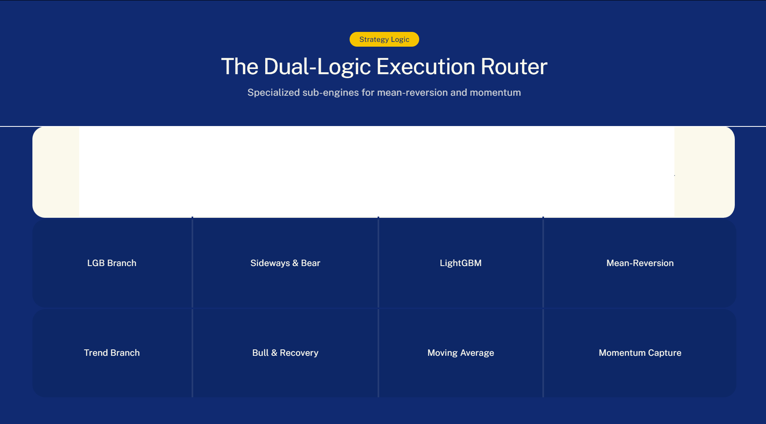
Logic Branch
Target Regimes
Algorithm
Strategic Goal

Slide 7
0.5
Entropy Kill-Switch
When Shannon Entropy exceeds this threshold, ARI enters a Hard Cash Lock.
Hard Stop-Loss
Maximum risk allowed per individual trade to prevent catastrophic loss.
5%
Capital Preservation
Total days spent in flat positions to survive the 2022 market crash.
531

Slide 8
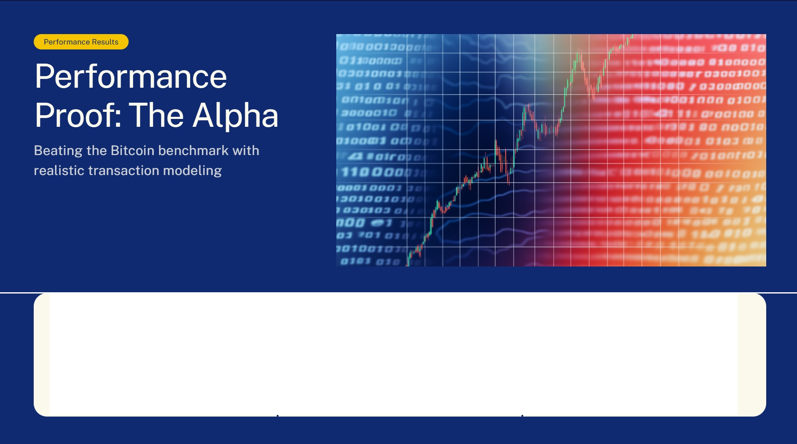
Alpha vs BTC
lS 27.16%
Excess return generated over the Bitcoin benchmark.
Net Strategy Return
49.51%
Total growth from 1.0 to 1.495 ending capital.
BTC Benchmark
® 22.35%
Standard market return over the same period.

Slide 9
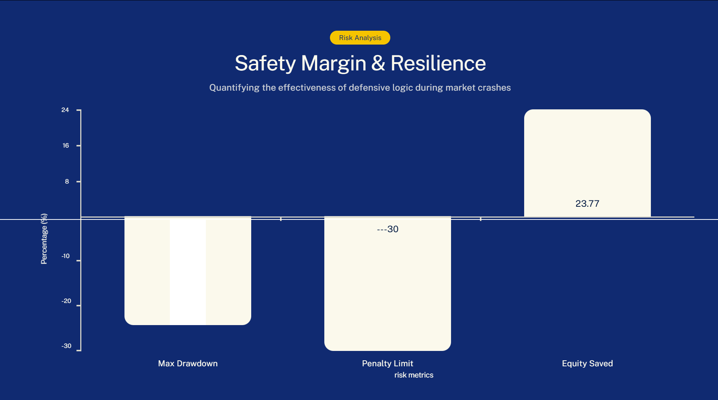
---24.26

Slide 10

Project ARI: Delivering institution-grade risk
The Future
management with market-beating alpha
Conclusion & Future Roadmap
Multi-Asset Scaling & Cross-Correlation Analysis
Sentiment Integration via LLM-based Entropy Tuning
Reinforcement Learning (RL) for Execution Optimization

